Slide 1
Paragraph writing
The process

Slide 2
What is paragraph?
A paragraph is a group of sentences about the same topic or main idea
A group of sentences
A clear main idea
Supporting information
Part of a longer composition
A miniature essay

Slide 3
Types of paragraph
Descriptive – to tell/to describe
Narrative - to express/to entertain
Expository – to inform/to explain
Persuasive – to influence/to persuade

Slide 4
Sections of a paragraph
Beginning - Introduce your idea with a topic sentence
Middle - Explain your idea with details and supporting evidence
End - Make your point again with a closing sentence
The topic sentence:
tells the main idea of a paragraph or what the paragraph is about
usually, the first sentence in a paragraph (but not always)
usually the most general sentence in the paragraph

Slide 5
Supporting sentences:
provide explanations and support for the topic sentence (main idea) of your paragraph
facts, examples, descriptions, or reasons
Closing sentence:
usually comes at the end of a paragraph
includes the same idea as the topic sentence, but in different words
sums up or reinforces the main idea

Slide 6
BRAINSTORMING
Prewriting and planning
organizing your ideas and beginning to put the information you have on paper
an informal way of generating topics to write about, or points to make about your topic
writing down all ideas in the order which they come to your mind
Shows your ability to pick and choose which topic is more important or which should go before another
record only ideas and phrases

Slide 7
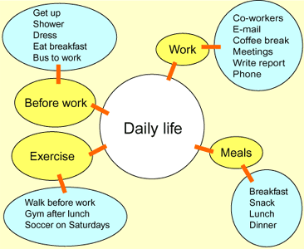
How to brainstorm?
Listing- make a list of ideas or related words with the topic
Clustering- To cluster ideas, write your topic in the center of a sheet of paper. Draw a circle around it, and surround that circle with related ideas, connecting the two together with lines

